Slide 1
Why REST API
The REST API Solution

Slide 2





Back in the Day
1995

Slide 3
Resources and Representational State
What are Resources
What is Representation State

Slide 4

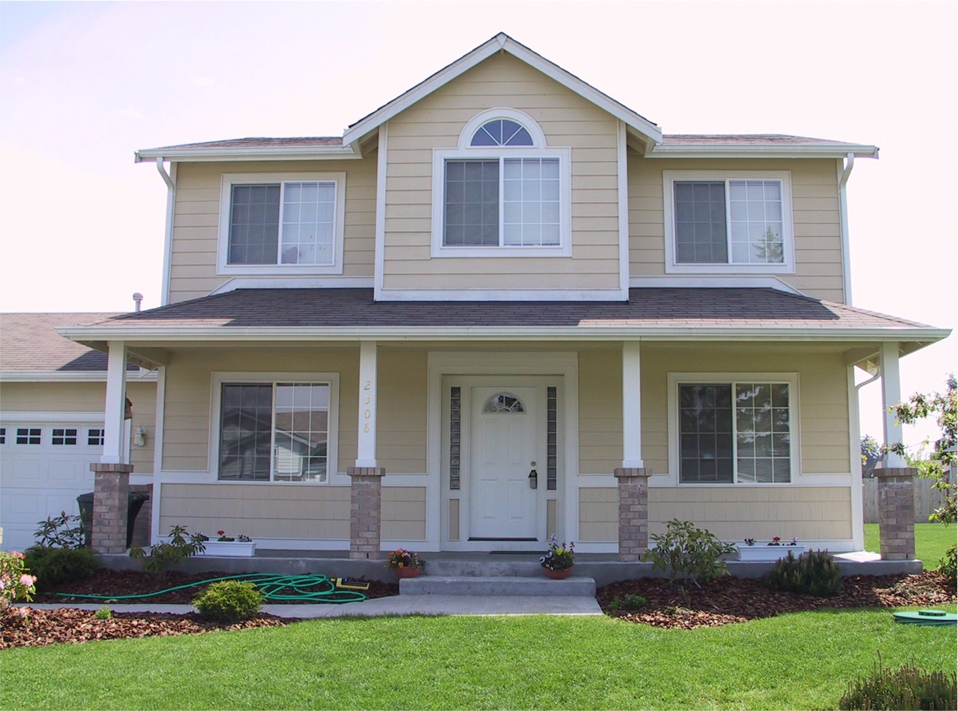
Resources
----- square footages
----- number of rooms
----- number of bath rooms
----- garage size
----- back yard size
---- bedroom footage
---- number of bedrooms
STATE

Slide 5

Representational State

Slide 6

Representational State
REpresentational State Transfer

Slide 7
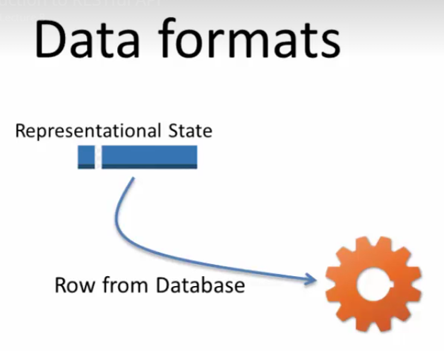
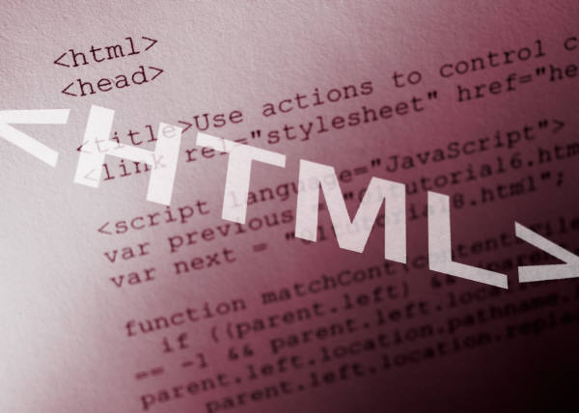
Data Format
What is the format of a Representational State

Slide 8



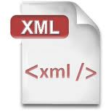

Data Format
What is the format of a Representational State

Slide 9
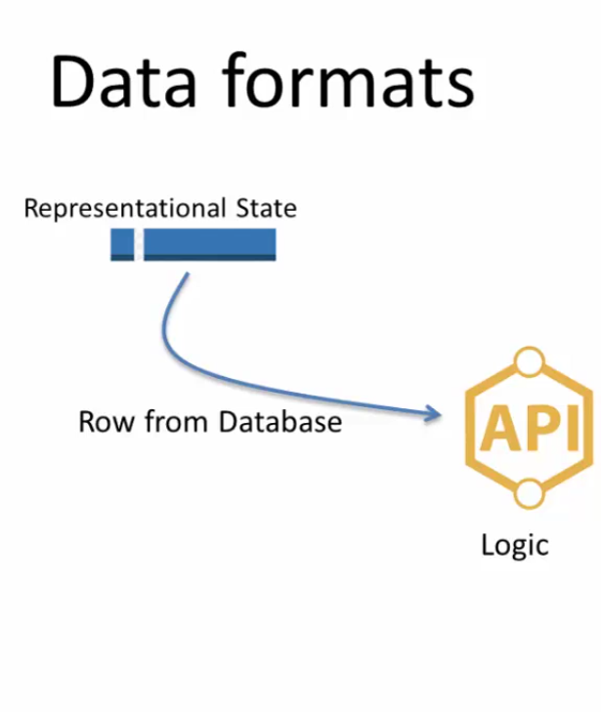
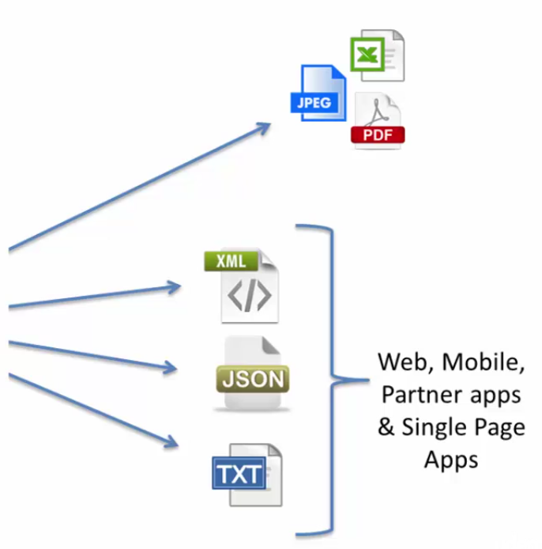
Data Format

Slide 10


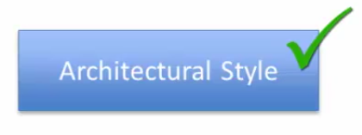
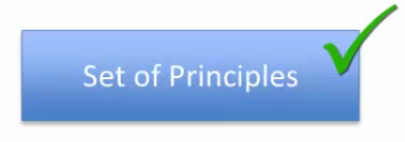
RESTful API
When is an API a RESTful API

Slide 11


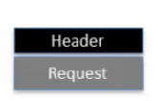
HTTP & REST API
PUT, HEAD, TRACE, OPTIONS
Relationship between HTTP & REST API
URL + Params + Verb = GET, POST

Slide 12
Header and Response
Response code =
200 (OK)
404 (Not found)
500 (Error)

Slide 13
Summary
Introduced you to the RESTful API
Much greater details
Resources
Representational State
HTTP

Slide 14
Dam it!!!
API is like a___________that is used by________instead of_________
Application, Human, Systems
Application, UI, Humans
UI, Applications, Humans
Human, UI, Application

Slide 15
WTF
XML parsing is sometimes_____intensive
Mobile
CUP
CPU
ROM
FileSystem

Slide 16
This SOB
REST Stands for
Representational State Transfer
Required State Transfer
Representational State Transmission

Slide 17
Who Cares!!
REST Must Use HTTP
True
False

Slide 18
He’s Nuts!!!
SOAP is a _______________based protocol
HTTP
JSON
XML
All the above

Slide 19
This is Annoying
A Resource in the context of REST is (or may be) ________
Thing
Object
Real world entity
An account
An item
A book
All the above

Slide 20
Too Many Dude!!!
In order to invoke an API on developer console most API provider requires the developer to get _________
User ID and Password
API Key
Registered to the site
Anonymous API does NOT require anything

Slide 21
I’m Getting So Sick of This
Companies like Google, WalMart etc offer only JSON based API
TRUE
FALSE

Slide 22
This is not cool!!!
The address of a house is an example of________
Resource
REST
Resource State change
All the above

Slide 23
Here We go Again!!!
RESTFul API make use of the HTTP
Headers (Request and Response)
Verb (GET, POST, DELETE, …)
Reponses code
Body
Parameters (query)
All of the above

